Slide 1
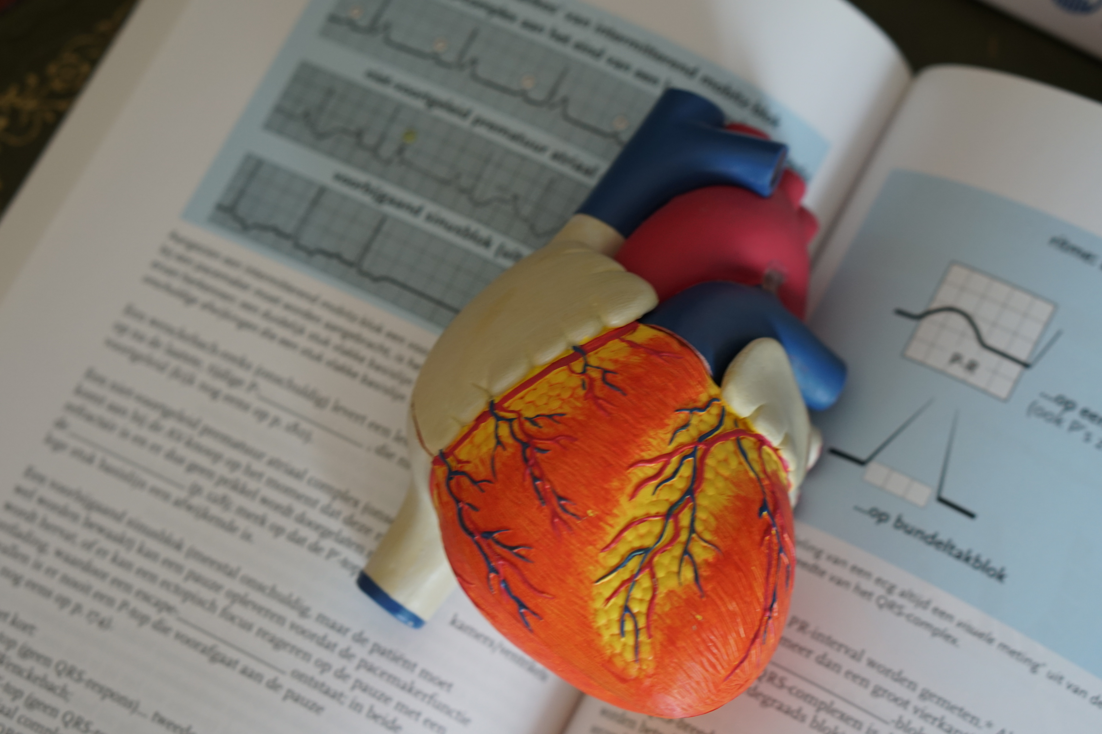
Teaching Clinical Case Presentations as Codified Speech Events
Michael Guest
English Dept., Faculty of Medicine
University of Miyazaki, Japan

Slide 2
What is a clinical case presentation?
Oral clinical case report
Performed worldwide
In-house (intra-departmental)
Core, situated speech event
Standardized/codified

Slide 3
How are CCPs carried out in NNES clinical settings?
Prince of Songkla University, Thailand Observed 36 Case Presentations
Thammasat University, Thailand in 12 Clinical Departments
Chiang Mai University, Thailand with 10 Extended Interviews
Can Tho University, Vietnam
Hong Bang International University, Vietnam
Hanoi Medical University, Vietnam
Yangon University of Medicine, Myanmar
Brawijaya University, Indonesia
Cheng Kung University, Taiwan

Slide 4
How are CCPs performed?
Peer-to-peer (informative: ‘interesting cases’)
Assessment (evaluation by senior staff)
Teaching sessions (instructional; bedside)

Slide 5
Why perform CCPs in English (in NNES settings)? According to interviewees…
Collaborative research/international faculty/preparation for int’l event
Brush-up for clinicians (given existing degree of L1-English
code-switching in clinical discourse)
*Holistic cognitive development of participants

Slide 6
Templates for CCPs generally include (1):
ID (basic patient data)
Chief/Present Complaint (CC)
HPI (OPQRST + associated Sx)
Current meds/allergies/treatments/complications
PMH (e.g. surgeries, hospitalizations, underlying conditions, injuries/trauma, treatments/therapies)
Family History
Social History
Take a photo!

Slide 7
Template for clinical case presentations (2):
Physical Examinations (including: vital signs, review of systems [ROS], HEENT, palpation/visual)
*Investigations (labs/imaging/pathology reports)
Summary (problem list/pertinent findings)
Initial/Provisional/Differential diagnoses (Dx)
*Post-admission developments/IPH
*Assessment and treatment/Management plan
*Interventions/Outcomes/Operational findings
Follow-up: Treatment successes/failures/adherence

Slide 8
CCP partial samples:
‘A 33-year old male presented with a persistent cough of 2 weeks’ duration accompanied by…’ (ID/CC)
‘Social history was significant for a 20 pack year habit.’ (SHx)
‘Based on the initial pathology reports, our tentative diagnosis was dense lymphoplasmacytic infiltrate, although we could not exclude hematologic malignancy.’ (Dx)

Slide 9
Notable features (1): Departmental emphases (Can you match them?)
Clinical Department:
a. Anaesthesiology
b. OBGYN
c. Respiratory
d. Community Medicine
e. Surgery
f. Endocrinology
CCP focus:
Labs/Imaging/Pathology reports
Social history (SHx)/Treatment adherence
Family history (FHx)/Labs
ROS/Physical Examinations
IPH/Post-admission developments
Management/Interventions

Slide 10
Notable features (1): Departmental emphases
Clinical Department:
a. Anaesthesiology
b. OBGYN
c. Respiratory
d. Community Medicine
e. Surgery
f. Endocrinology
CCP focus:
Labs/Imaging/Pathology reports (e)
Social history (SHx)/Treatment adherence (d)
Family history (FHx)/Labs (c)
ROS/Physical Examinations (f)
IPH/Post-admission developments (b)
Management/Interventions (a)

Slide 11
Notable features (2): Negative data/omissions
‘The patient showed indications of pulmonary tuberculosis but there was no FH of same and the AFB was negative, therefore we changed our initial diagnosis to…’
FH/SH are usually irrelevant to ER victims of blunt force trauma (and thus was omitted in Emergency Med CCP)

Slide 12
Notable features (3): Use of professional register/ multimodal use of acronyms/abbreviations/ellipsis
‘The presence of X indicates a greater likelihood of Y infestation’.
‘SH was significant for high alcohol intake but was otherwise unremarkable’.
‘In that time we don’t know if it is infect or not infect.’ (NNES structural errors)
(written) PET scan revealed a RUL mass of 2x1.5 cm, w/suspected rt hilar and rt interlobar nodal metastasis + possible bilateral adrenal metastasis.
(PE/Labs) ‘BP 105/65 no change, visible ecchymosis, and RS stridor.’

Slide 13
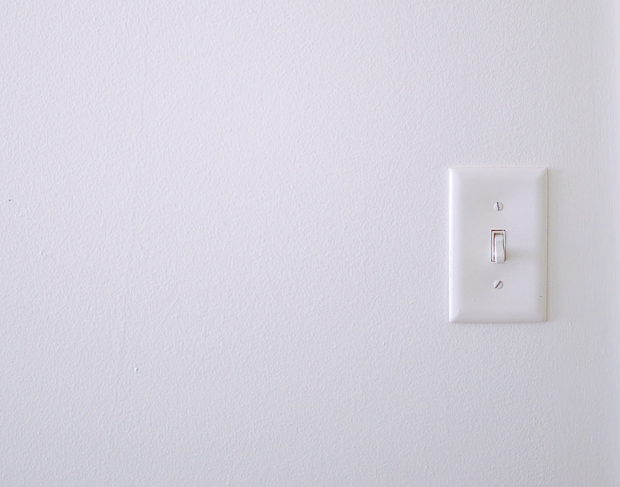
What is the value in mastering CCPs?
Marks membership in int’l medical discourse community
Helps develop sense of professionalism:
- Organizational skills, prioritization of data
- Rhetorical skills, narrative flow
*Washback effect on L1 in NNES workplace

Slide 14
1. Emphasizing the narrative structure (holistic) 2. Prioritization of data (pertinence & significance) 3. Omission vs. Commission (selective content) 4. Use of professional register 5. *Learners providing their own clinical data
Hints for the effective teaching of CCPs. Focus upon:

Slide 15
mikeguest@med.miyazaki-u.ac.jp

